Slide 1
HandsMen Threads: Elevating the Art of Sophistication in Men's Fashion
By-Srilaxmi Vallampatla

Slide 2


Slide 3


Slide 4


Slide 5


Slide 6


Slide 7


Slide 8


Slide 9
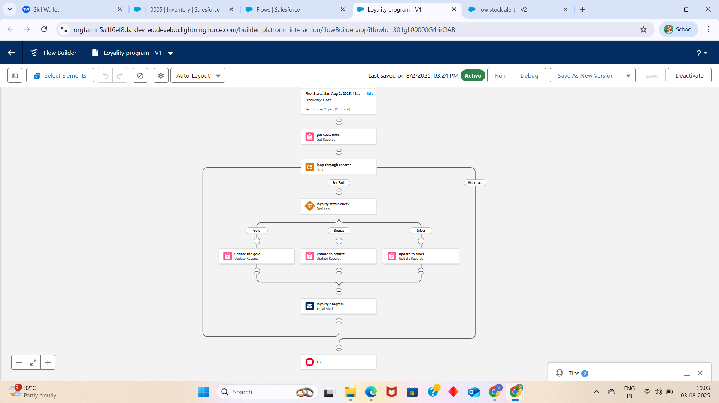
Story for illustration purposes only

Slide 10


Slide 11


Slide 12


Slide 13


Slide 14
THANK YOU

